Slide 1
The Opioid Project Analysis of Opioid Pills Distribution in USA
Ashok Singh, Chris McCown, Gilberto Ramirez, Christopher Glessner
UNC Data Analytics Boot Camp – Project 2
October 1, 2019

Slide 2

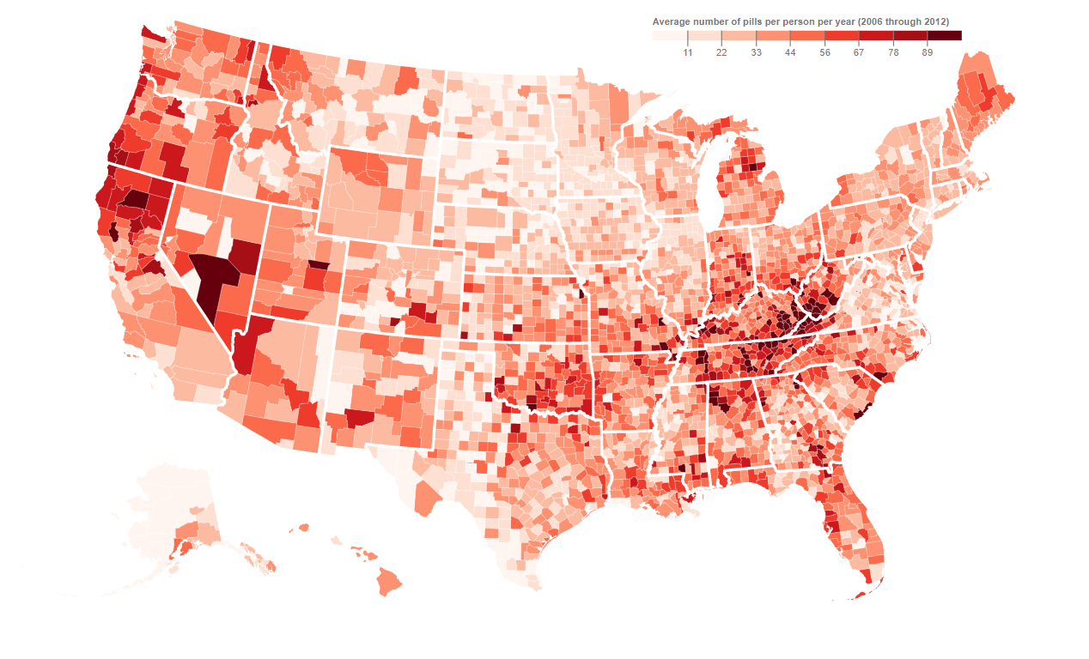
The Opioid Project Overview
Opioid is one of the biggest epidemic of our times, so wanted to analyze it in more details
76 billion pills, 380 million transactions in 7 years from 2006 – 2012
Over 100,000 deaths in these 7 years, many lawsuits ongoing
Hydrocodone and Oxycodone were the main drugs

Slide 3
Data Sources
Drug Enforcement Administration (DEA) Opioid drugs database, which was provided by Washington Post: Tracks the path of Opioid drugs sold in the United States, by manufacturers and distributors to pharmacies in every county
https://www.washingtonpost.com/graphics/2019/investigations/dea-pain-pill-database/
API to access the DEA’s Automation of Reports and Consolidated Orders System (ARCOS) data prepared by The Washington Post
https://arcos-api.ext.nile.works/__swagger__/
https://arcos-api.ext.nile.works/swagger.json?schemes=https&host=arcos-api.ext.nile.works&path=/

Slide 4
Data Preparation
Raw data summary:
Type: TSV
Size: 80 GB
Rows: 180 M
Every transaction, 2006-2012
API summary:
Aggregated data
Population
Pharmacy locations
Variable | Levels | Required by
State/County | 3242 | All
Year | 7 | All
Subtotal | 22,694 | All
Manufacturers | 89 | Sankey, Choropleth
Distributors | 367 | Sankey
Buyers/Pharmacies | 44,344 | Sankey, Heat/Cluster Maps, Line Graph

Slide 5
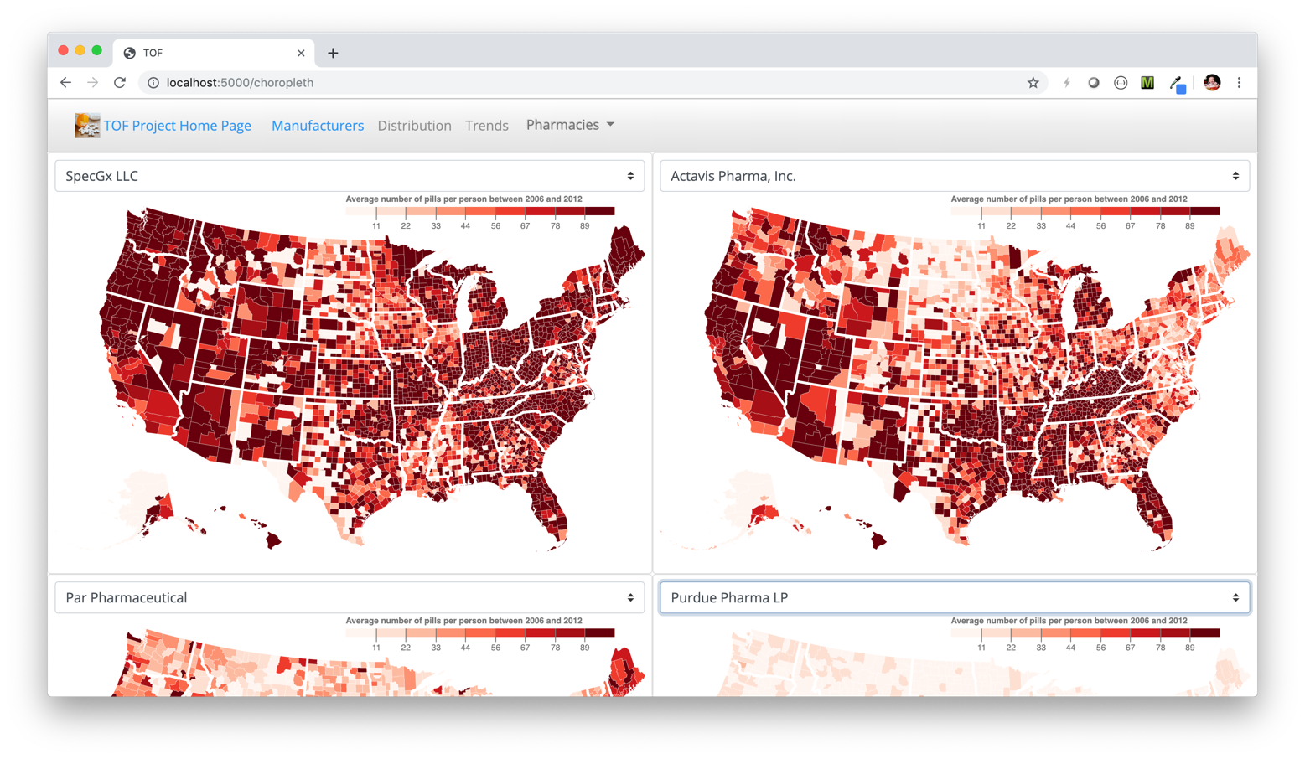
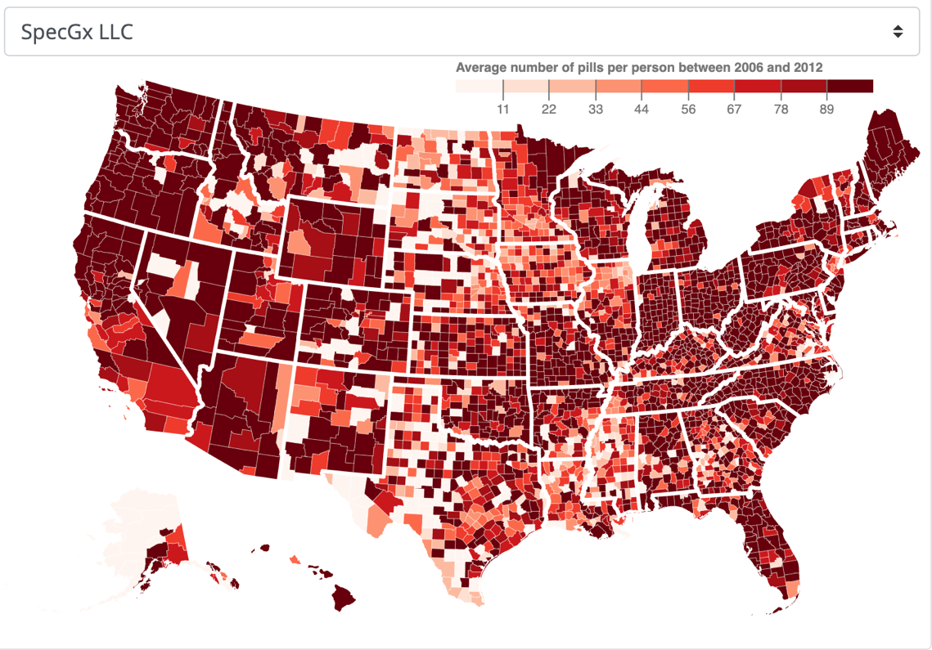
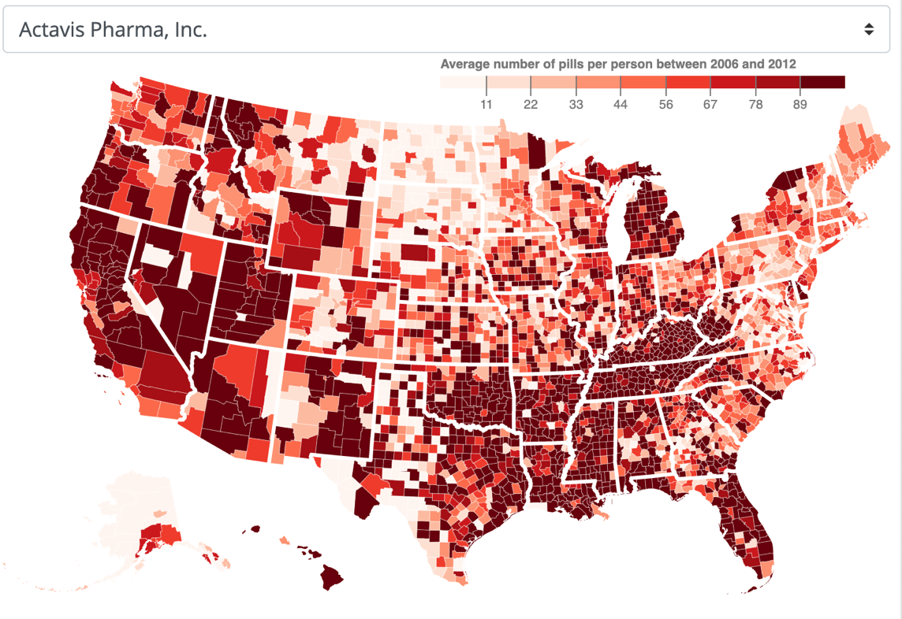
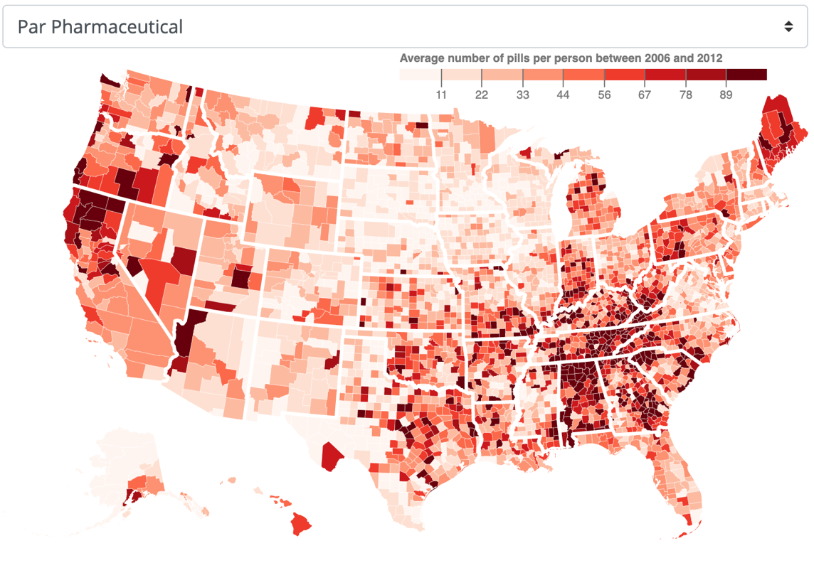
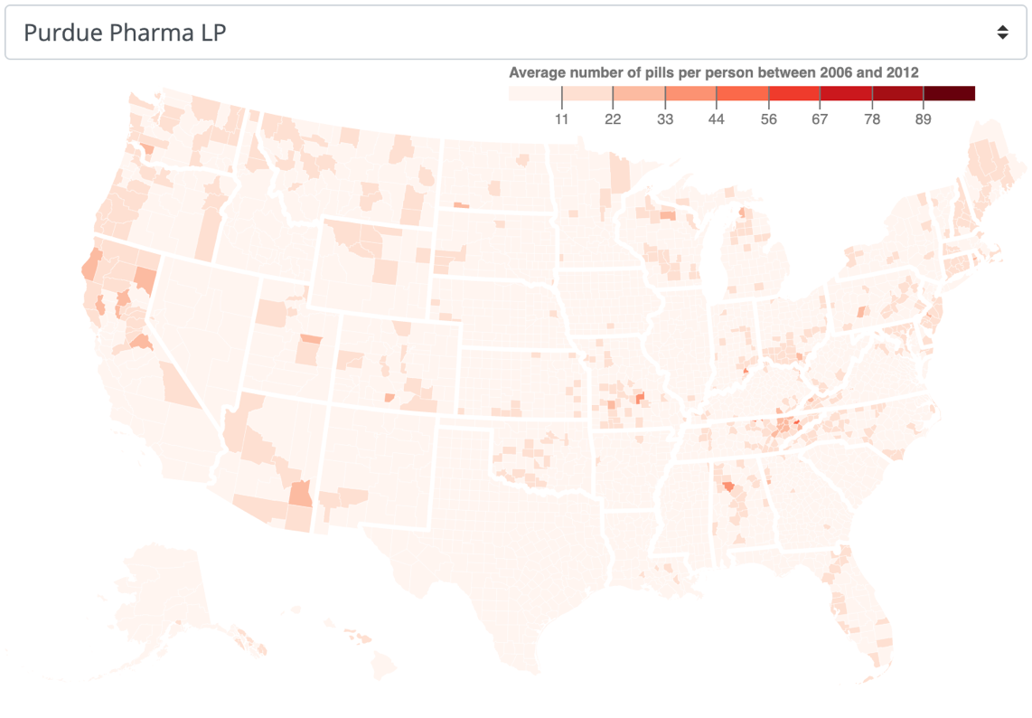
A view into the opioid manufacturers…
Tool to explore pill distribution from specific a specific manufacturer.
Three manufacturers are dominant (88%).
In many areas one manufacturer dominates over the other or is focused on.
Notes:
Three companies manufactured 88 percent of the opioids:
SpecGx (subsidiary pf Mallinckrodt) – 38%
Actavis Pharma – 35%
Par Phamaceutical (subsidiary of Endo Pharmaceuticals) – 16%.
Purdue Pharma comes in fourth place with 3% of the market but is said that sparked the epidemic in the 90s but has three percent of the market.
Pills went up from

Slide 6
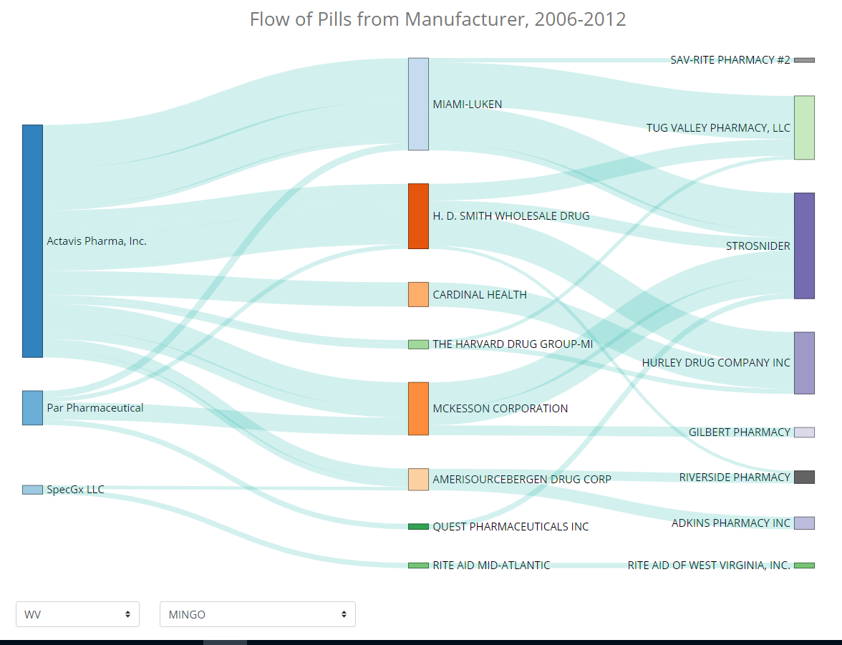
Distribution Analysis
From 2006 through 2012, nationally, most of the pills flowed from 3 main manufacturers to 6 distributors to local buyers.
Understanding the supply chain helped explain how the crisis evolved.

Slide 7
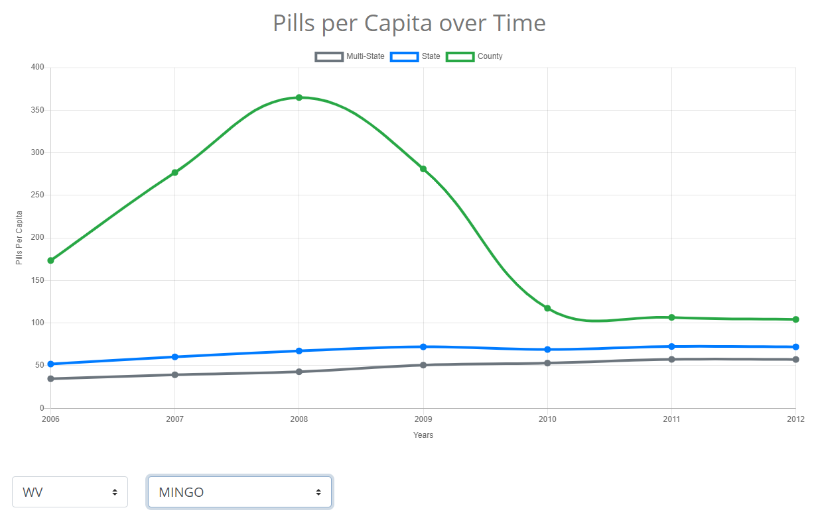
Trends Analysis
Most states reflect an increase in pills per capita from 2006 through 2012.
Individual counties show greater variation.

Slide 8
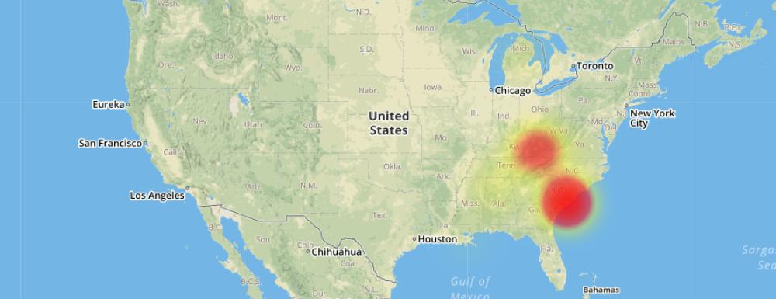
Pharmacies Heat Map Analysis
Per Capita pills distribution and Addiction Index was very high in few areas
Problem was particularly worse in some parts of South Carolina

Slide 9
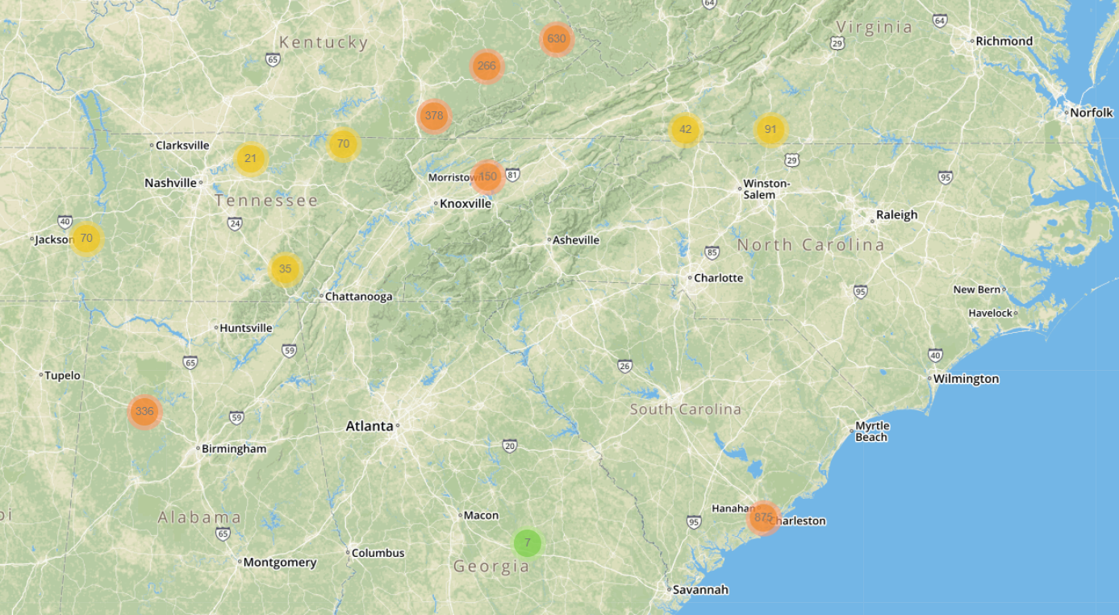
Pharmacies Cluster Map Analysis
Appalachian Region pharmacies were shipping large amount of per capita pills
Charleston area pharmacies were shipping large amount of per capita pills

Slide 10
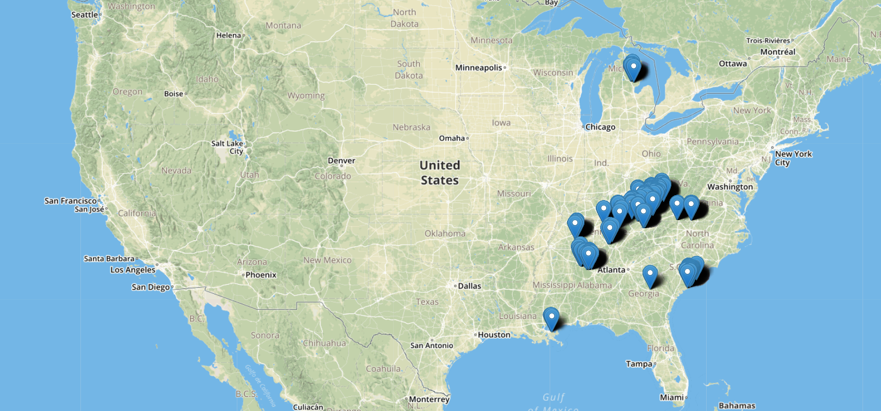
Pharmacies Marker Map Analysis
In many of West Virginia and Kentucky counties, per capita distribution was over 200 pills per year
In Charleston SC, per capita pill distribution was over 1 pill per day

Slide 11
Conclusion
Handful of companies manufactured, distributed and benefitted from high usage of the Opioid drugs.
Per capita pill distribution was very high in some of the counties. Higher pill distribution per capita should have flagged potentiation misuse of the Opioid drugs.
We need to continuously monitor and analyze the distribution and usage of major drugs, identify any potential misuse, and enforce the laws in-time.
While doing the data analysis, we have also created the tools, which can be used to easily explore and analyze other data trends
Notes:
Although life expectancy has increased at the global level in the last decades and increased quantity varies among countries, there is a high disparity between developed and developing countries.
Ideas for next steps:
Determine which 5 countries have the highest GDP
Determine which 5 countries have the highest Life expectancy
Determine the relationship between GDP and Life expectancy

Slide 12
https://data-vis-el-chapo.herokuapp.com/

